Slide 1

People Still Read?
Understanding the Current Reader Behavior Landscape of Today to Influence Publishing of Tomorrow
Mallory Banks
Metis Module: Business Fundamentals

Slide 2

Goals, Impacts, and Solution Path
Goals
The Goal of this Analysis is to understand the landscape of reading in the modern Era by processing a survey on reading habits of different demographics as well as analyzing one of the most popular reading social networks today
Impacts
The Impact this can have for the client is that they will be able to create a new concept of what the “traditional” reader looks like based on the datasets explored. Additionally, they may be able to increase traditional book sales based on devising new and more applicable marketing campaigns that identify and galvanize readers that may have been underserved to this point.
Solution Path:
Data Acquisition from GoodReads (Dataset procured from now defunct GoodReads API) and Dataset of Reading Habits Survey 2020 from Pew Research Center
EDA: After Using Google sheets to Explore re-sampled Survey data on racial categories , Python to Manipulate/concat massive Book Dataset, divide into Highly Rated and Lowly rated
Insight Gathering with Excel: Tagged “High Activity” Readers to Understand Demos of Readers who are reading above national Average of 11 books per year or the median of the dataset (6 books per year).
Insight Gathering with Tableau: Looked at attributes of Highly Rated Books and Lower Rated Books to Understand Differences
Future Steps: Classification Research needed to understand attributes and groupings of book types leading to higher reviews

Slide 3
Assumptions and Risks Impacting this Project
Risks
Due to the limited nature of research done on Literacy in the United States, the responses of Reading habits surveys are skewed White and Upper Class. Some of this is mitigated with slight upsampling, but the fact remains that survey data will be biased
Because Good Reads retired it’s API once it was acquired by Amazon, we aren’t able to go back and easily collect even more data leaving the dataset limited only the years of publication through to ~2013 (and even this is a little shakey). This analysis acts as a proof of concept for increased funding in literacy and reading research
Assumptions
Because of the Risks as previously states, we are assuming that Good Reads and its users are a good representation of public POV on Books themselves based on their ratings. We know that these things can change quickly and more so, that there are many other places that readers are entering to make their voices known (booktok, bookstagram, startups like Story Graph, and Amazon Reviews)
Additionally, we are assuming that the survey data collected by Pew in 2020, though self reported, is good faith answered by respondents and a good proxy for a wider range of different types of readers

Slide 4
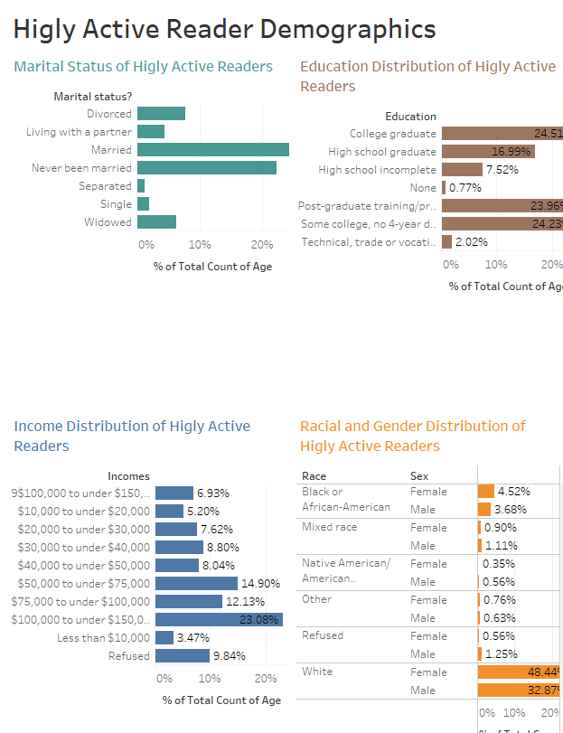
Who is Reading The Most These Days?
Across the Board, Women are reading the most (60% vs 40%) But 78% of books are about men. Generally, Higher Income household read at highest rates, as well as more highly educated communities
Notes:
Reader Behavior | Tableau Public

Slide 5
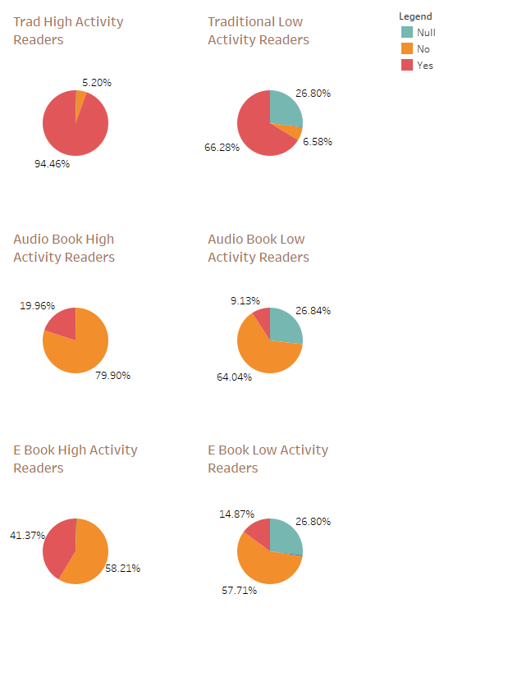
How Are Readers Reading Across Activity Levels?
While we do see that many Highly Active Readers read across many different mediums, Low activity readers are those who mainly stick with traditional publishing - is there room in publishing to bring new types of reading behavior to “Low Activity” Readers
Notes:
Reader Behavior | Tableau Public

Slide 6
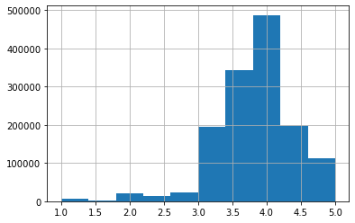
Histogram of Avg. Rating of 1.2M+ Books on GoodReads
Do Folks Care About What They Are Reading? Do they take to the internet to complain or share the love?
Yes! Though, many books rated on GoodReads are those that are Highest Rated. Contrary to the idea that most people online on want to complain! Is there in house survey research that could work to continue to fill out this story?
Average Rating On GoodReads

Slide 7
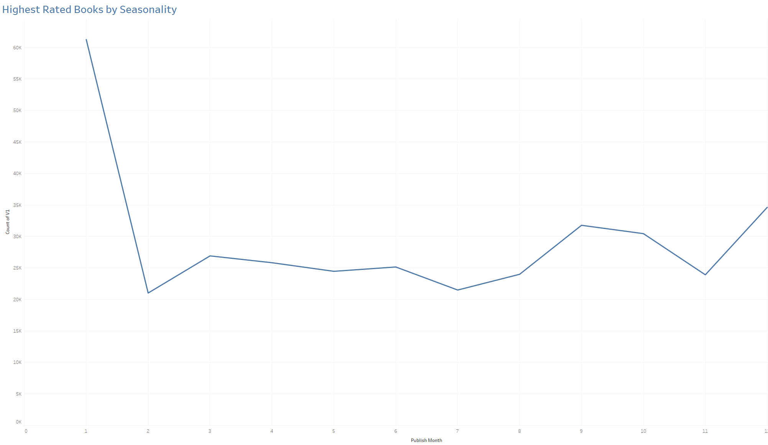
When do the Best Books Come Out?
Slight Increase MoM in March ( Women’s History Month), Given what we know about Gender amongst readers - is there more to be done?
Minimum at Feb (Black History Month) - missed opportunity?
When Subsetting on Books Rated higher than the mean, we see that these books are Most Likely to be released in the winter season. Books Released in the Winter Season
Notes:
Good REads Highest Rating | Tableau Public

Slide 8
Conclusions and Future Research Needed
Across the board, and perhaps contrary to some popular belief, the female demographic is most likely to be highly active readers
The Max of Books Read of Respondents is 97 in a single year
Many High Activity Readers use GoodReads as less of a “Complaint” mechanism and more of a “Social Network” mechanism where they discuss the things that mean the most to them, thus a mean average of 3.83 rating (Higher than one might think). How do we work to harness this activity. What partnerships do we have with “Book Influencers”
Is it true that the highest rated books are released during the holidays? Or are more books writ large during the holidays
Further Data Science Work needed to scrape in Genre, get access to total book revenue data as this dataset is a prime candidate for classification/Regression work

Slide 9
Appendix

Slide 10
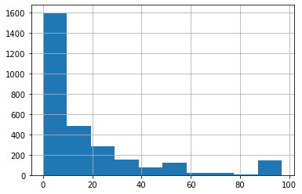
Distribution of Survey Q “How Many Books Read in the last Year” by Respondents

Slide 11
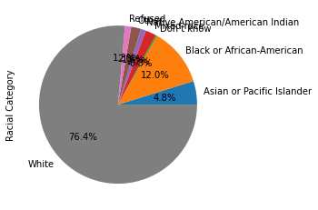
Racial Distribution of Reading Habits Respondents

